Slide 1
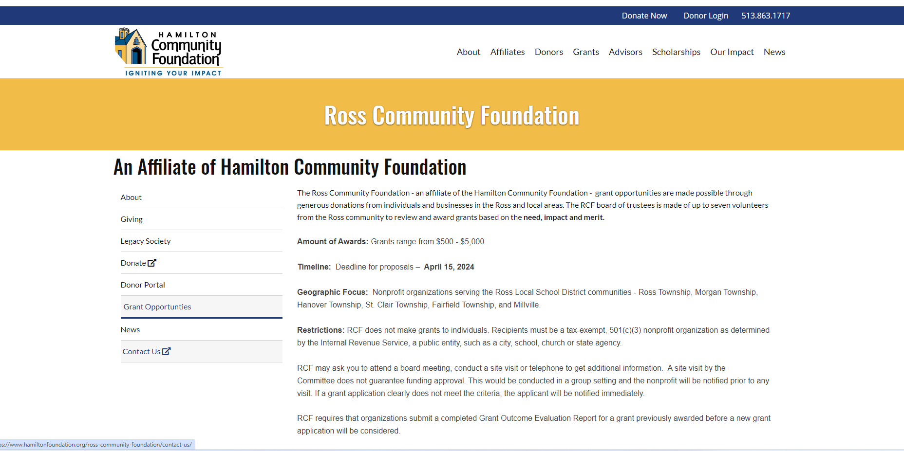
Scroll Down the Page
Notes:
Scroll Down the Screen
Next

Slide 2
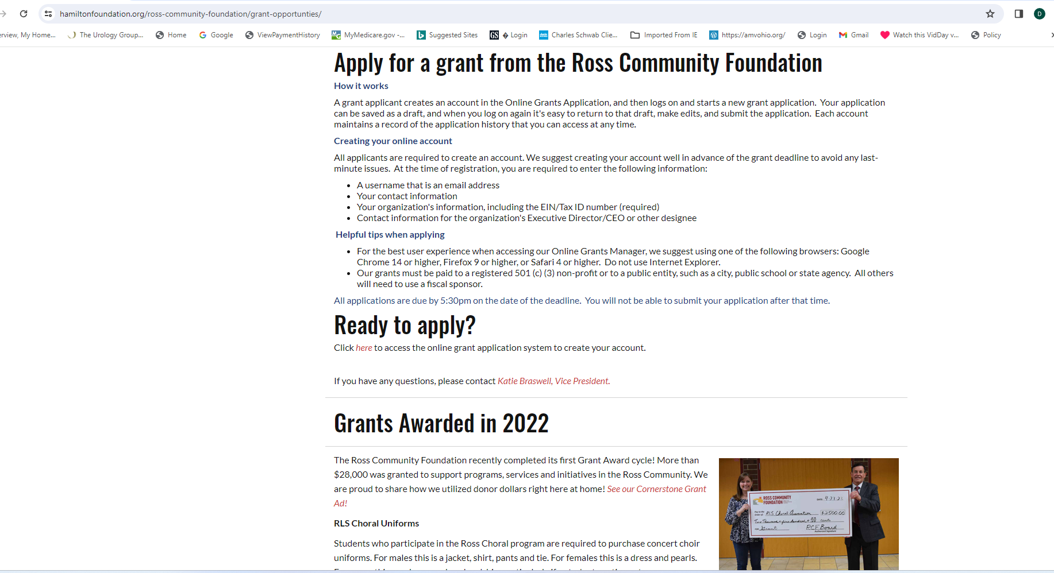
Notes:
If you have read the instructions and understand them and have gathered the needed data you are ready to go.
Next

Slide 3
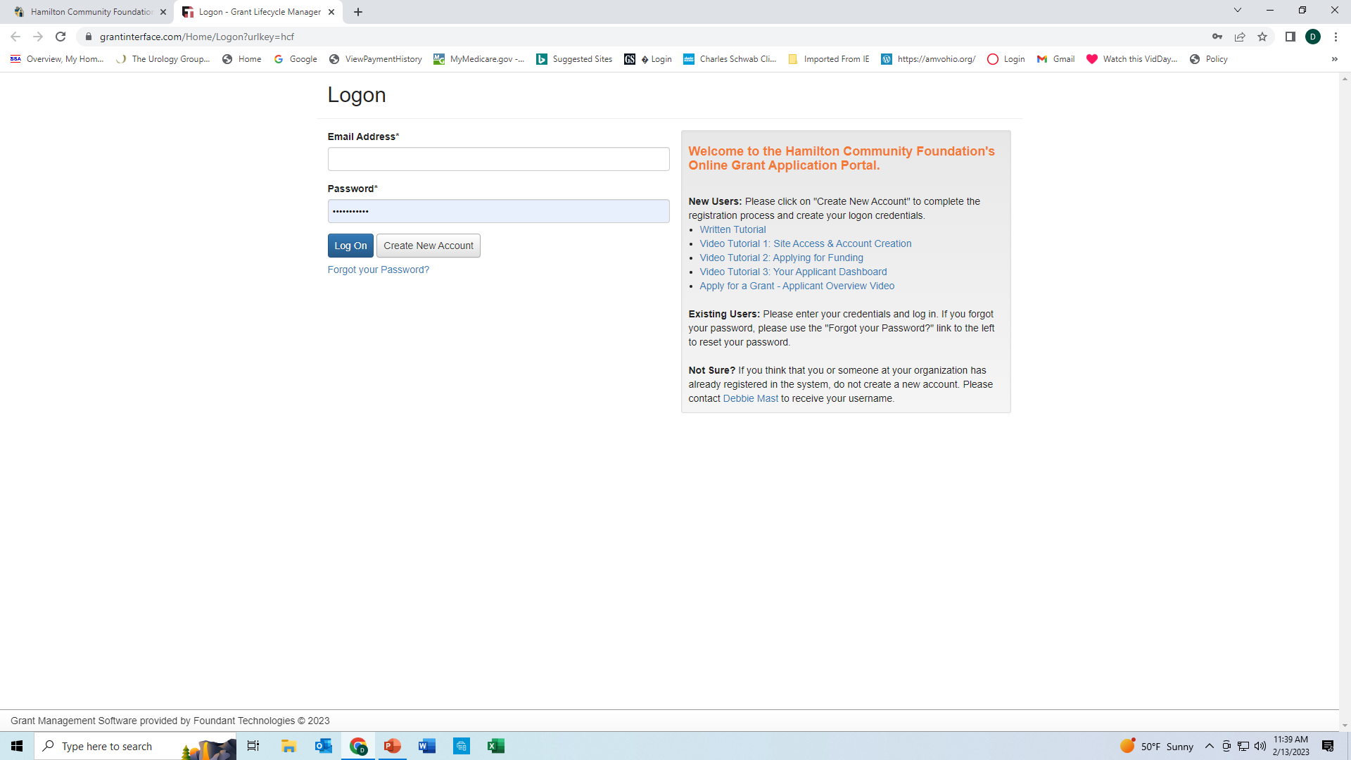
Notes:
Note the video and written tutorials
Click Create New Account. If you have already been on the HCF site use your ID and PW
Next

Slide 4
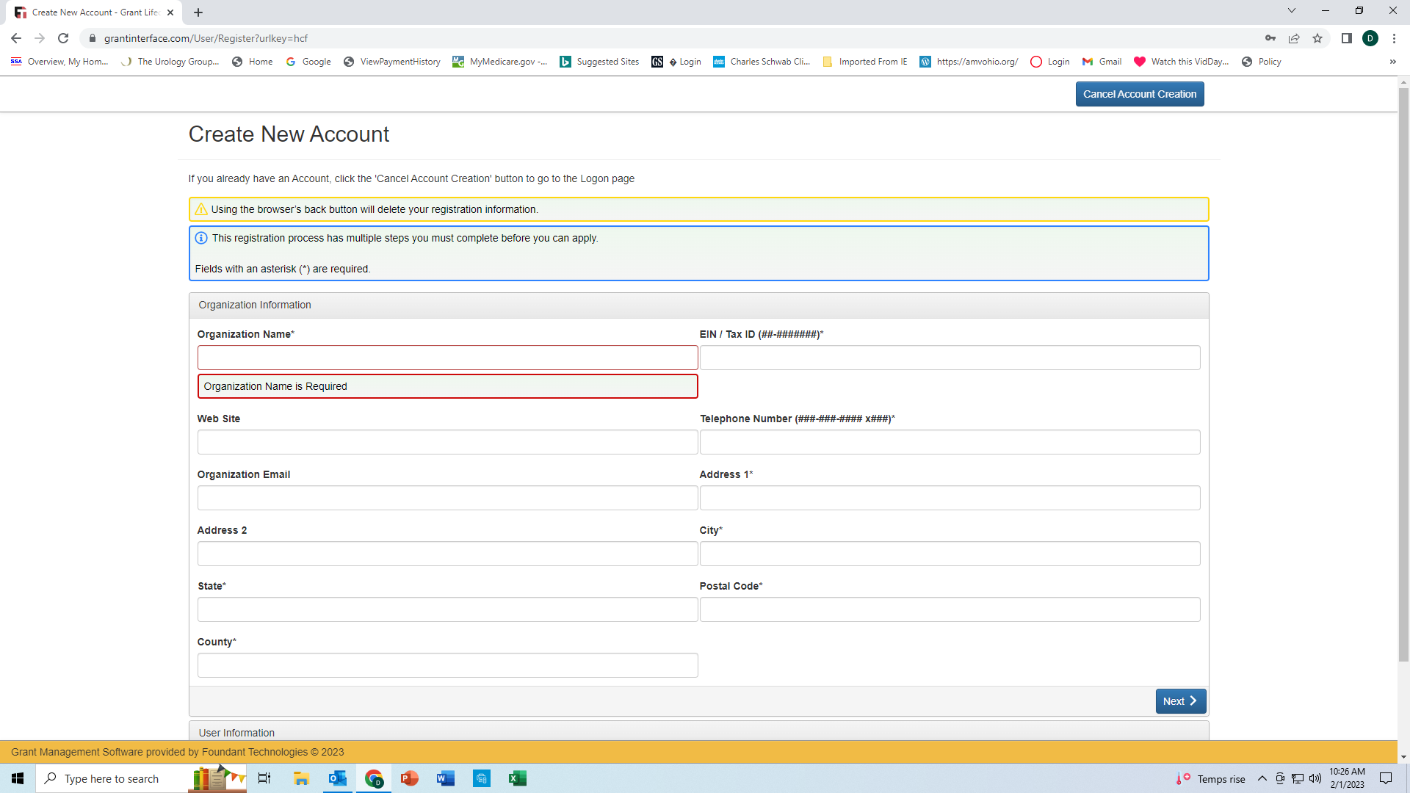
Venice Historical Society
84-XXXXXXX
venicehistoricalsociety.com
513-893-0989
venicehs@gmail.com
5445 Hamilton Cleves Rd
Hamilton
OH
45013
Butler
Notes:
As mentioned there are 3 sections to completing this application- Organization information, User information and finally Apply for a Grant . Let’s get started
Organization information – this is in reference to the actual organization, club or society requesting a grant.
Things to note on this slide
Note dashes for EIN number, phone number, state is 2 capital letters only.
Discuss the Cancel Account Creation- can click on this any time to delete the application
All questions with an asterisk must be completed

Slide 5
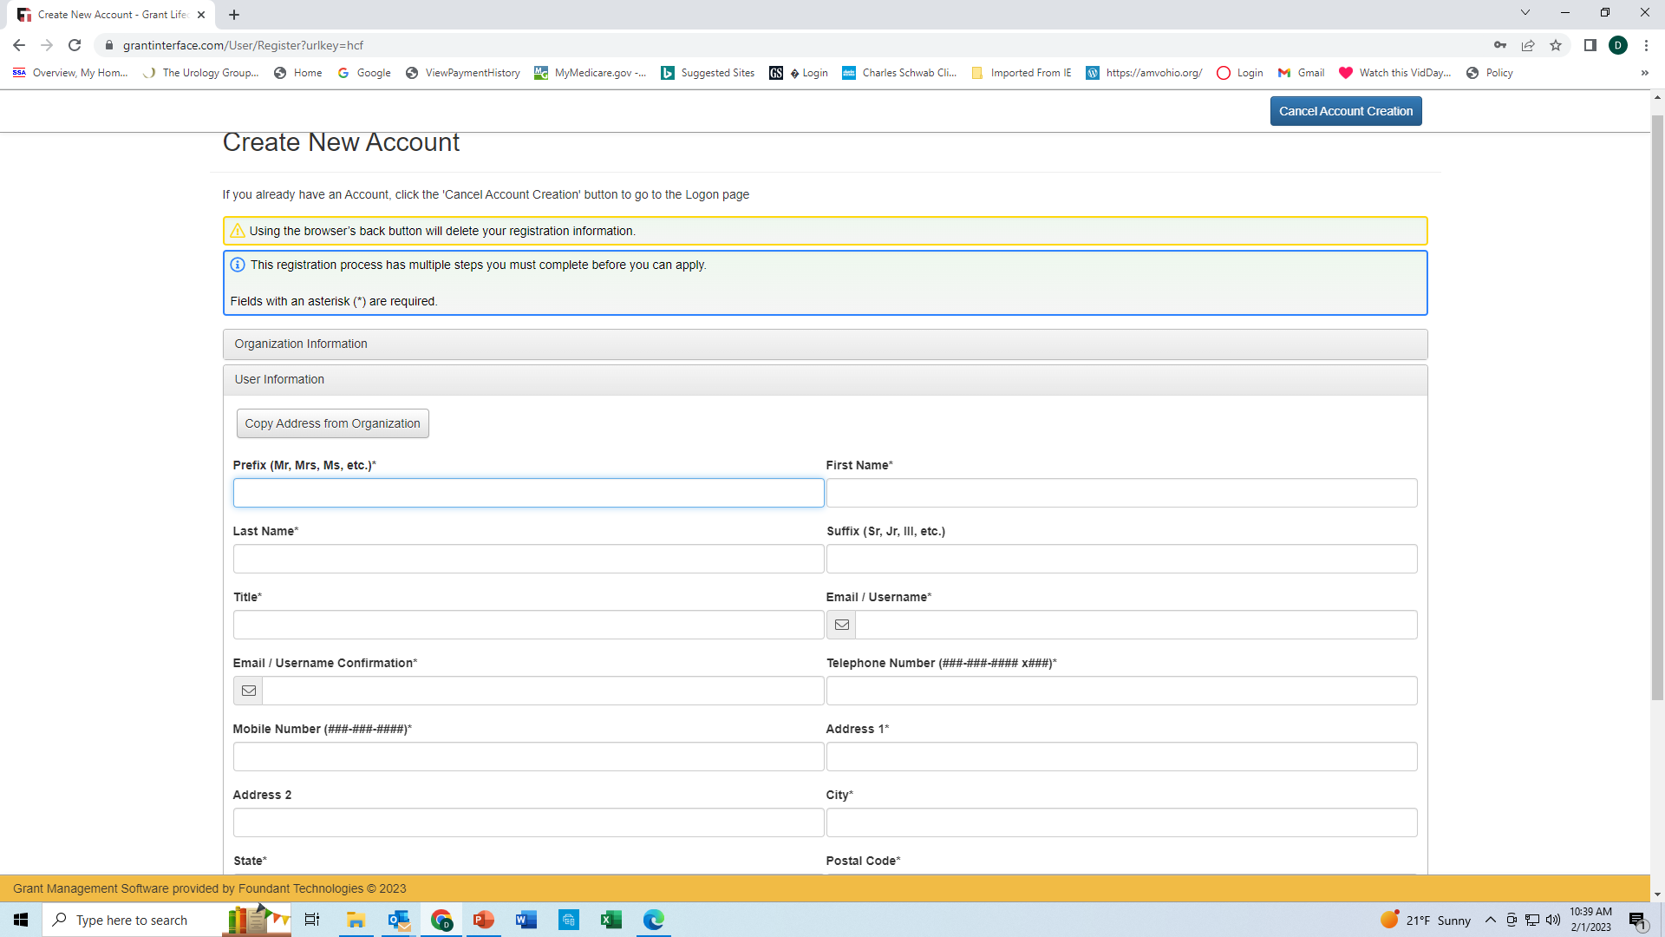
Ms.
Martha
Mehl
Chairperson
mehl.martha@fioptics.com
mehl.martha@fioptics.com
513-893-0989
513-460-0622
2085 Demoret Ln
Hamilton
Notes:
2. User Information the organization needs to decided who is responsible for filling out the grant it may be an executive position or other but the User is YOU.
Things to note
Point out the Copy address from Org button if applicable
User to provide a e mail if not using the organization as the user e mail will become the applicant user in the system
Must select a prefix
Dashes in phone numbers etc
Next

Slide 6
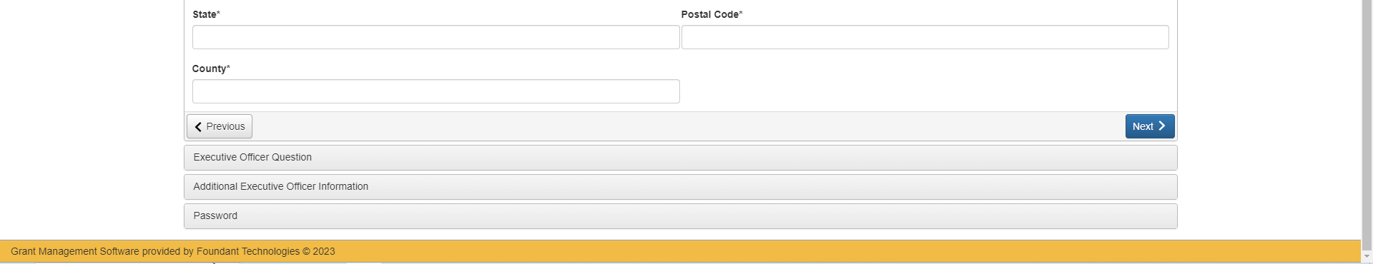
OH
45013
Butler
Notes:
Finish completing the User information
Must use Previous Button if you use the Backspace on your key board / browser you will lose all registration information entered.
Next

Slide 7
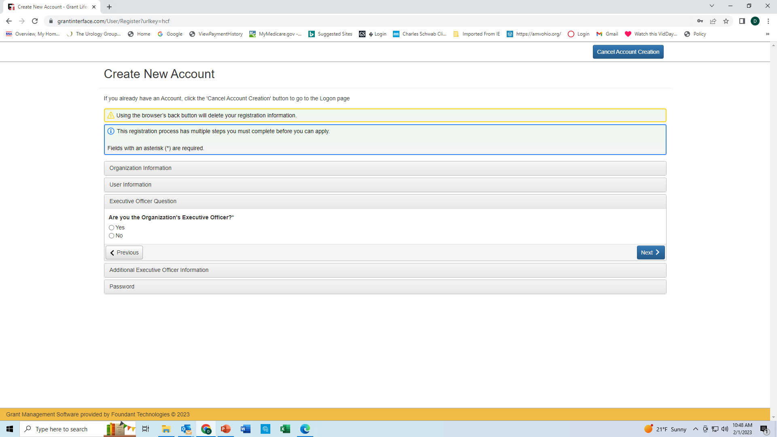
.
Notes:
Note that in this slide we have said YES as being the Organization Executive Officer that will take us to the next screen
If not the Executive Officer click No, Next
Next

Slide 8
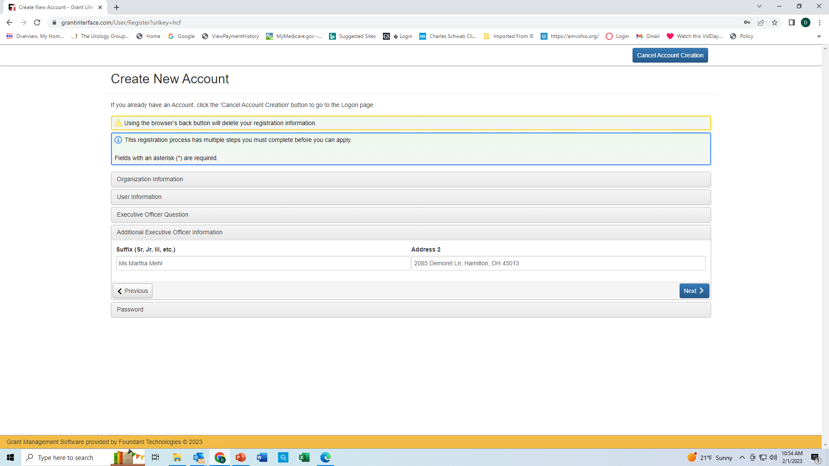
Ms. Martha Mehl
2015 Demoret Ln, Hamilton, OH 45013
Notes:
On this screen it asks for the prefix and address of the Executive Officer
Next

Slide 9
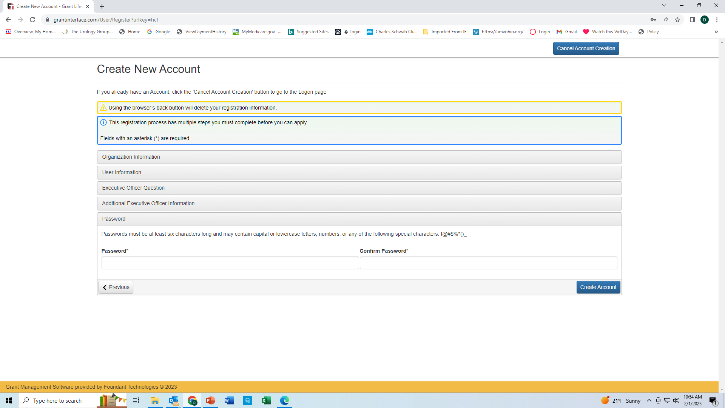
mehl.martha@fioptics.com
mehl.martha@fioptics.com
Notes:
Note passwords must be at least 6 characters long and may contain capital and lowercase letters, numbers or any of the following special characters
! @ # $ % * () _
When completed click on Create Account

Slide 10
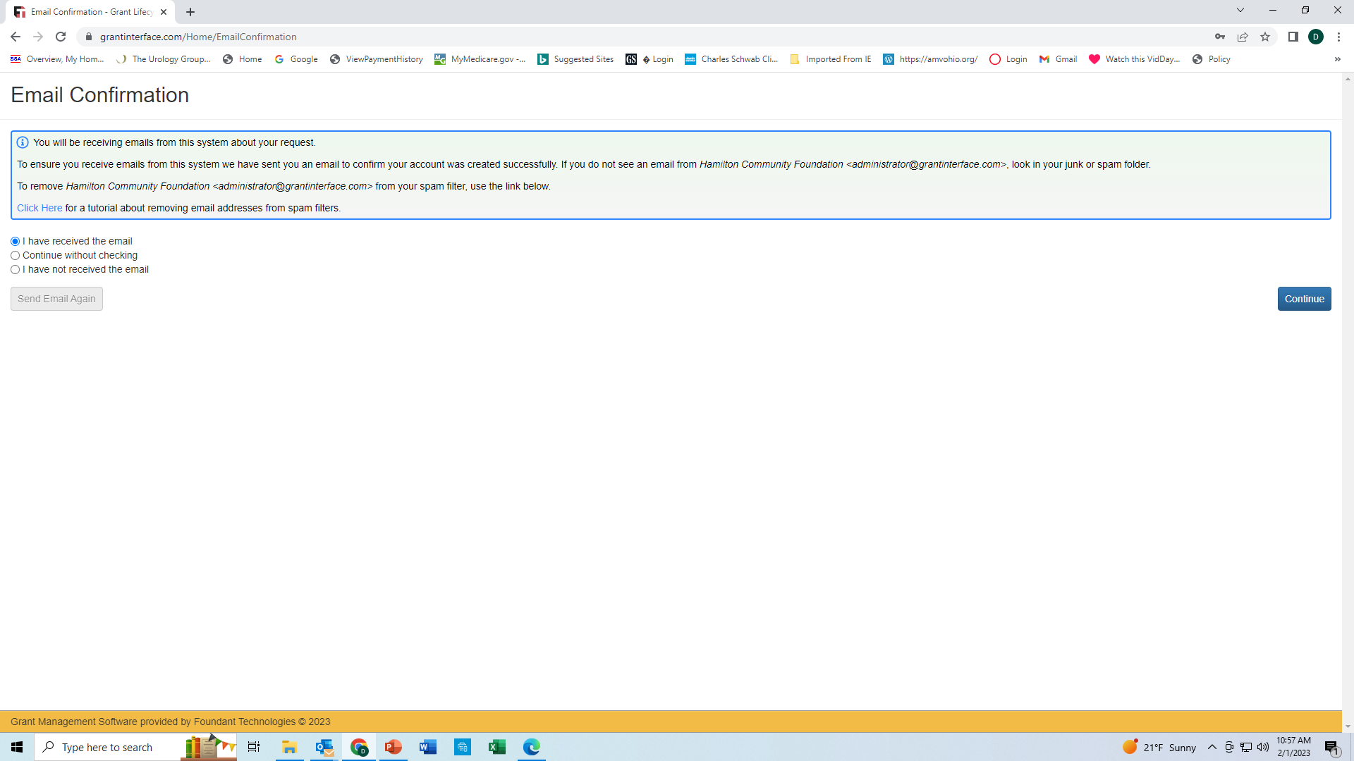
Notes:
This is the e mail confirmation page by clicking I have received the email you are confirming that you are in the system and are identified as the User by your e mail entered .
Continue

Slide 11
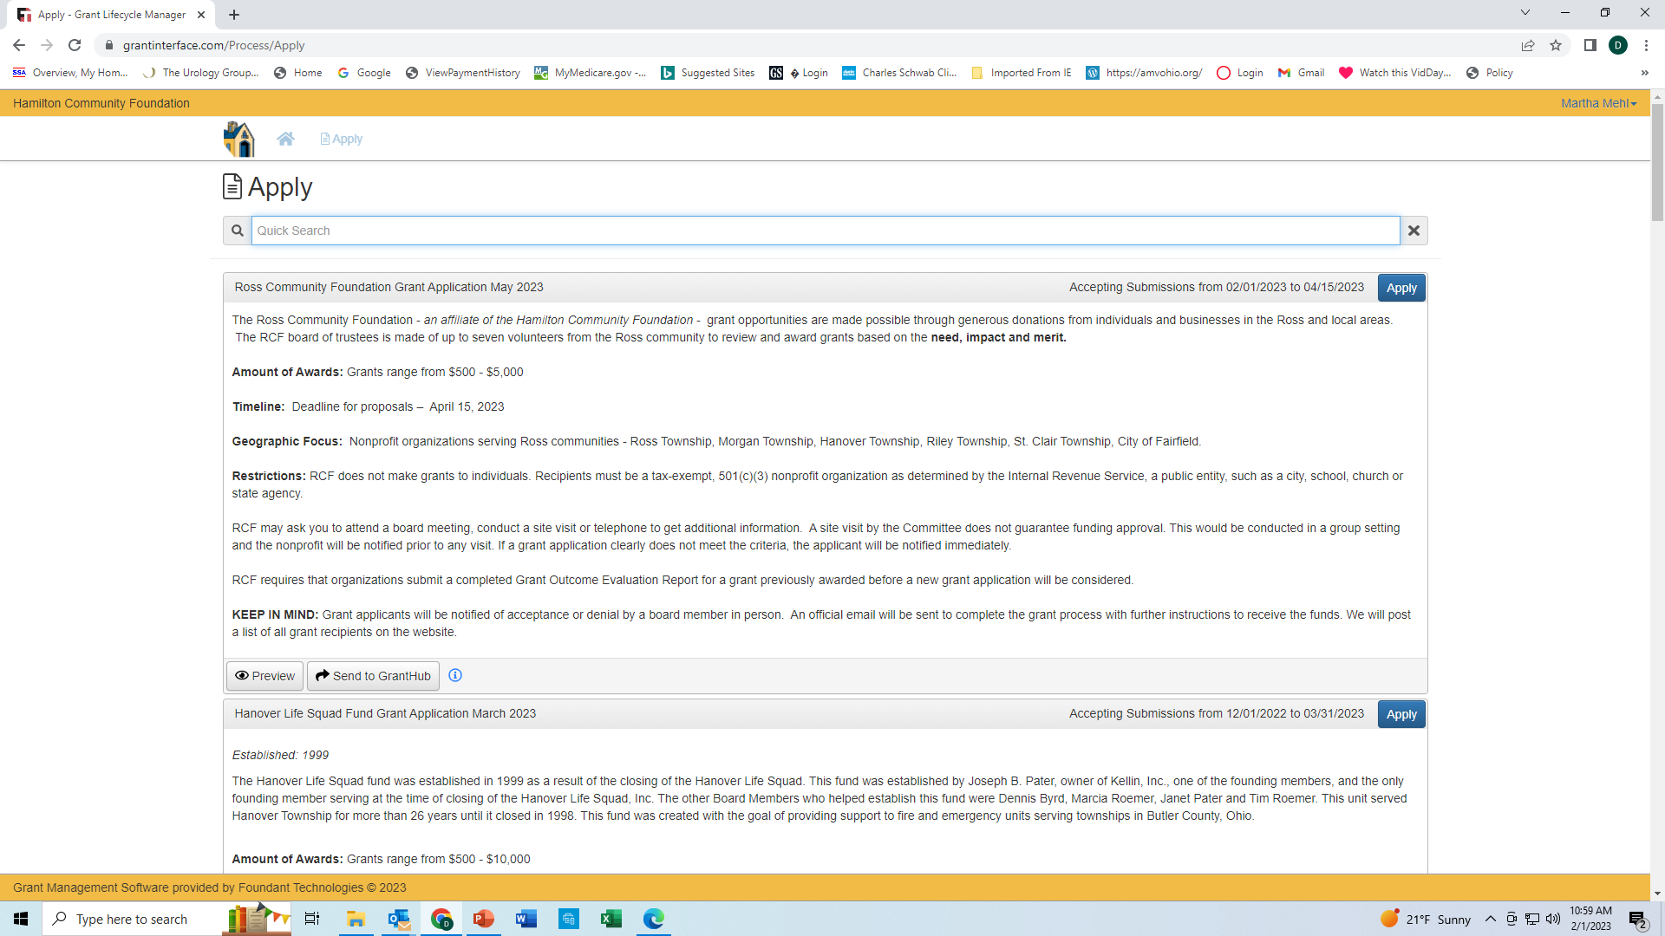
Notes:
3. Apply / Application you are ready to complete a application for a grant .
Summary:
We have completed Organization Information, User Information and established a User name to be identified in the RCF system
Things to note:
Read first sentence and note to the grantees NEED, IMPACT, MERIT these are the criteria that the board will use in assessing the applications and deciding on who receives the funds.
Review all statements remaining on the page through Keep in Mind.
Major note at the bottom of the screen there maybe other grants that are available to your organization that you might want to apply.
Note if you attempt to upload a file that is larger than the set MiB you will receiver an error message informing you that it is too large and will not be SAVED
Apply

Slide 12
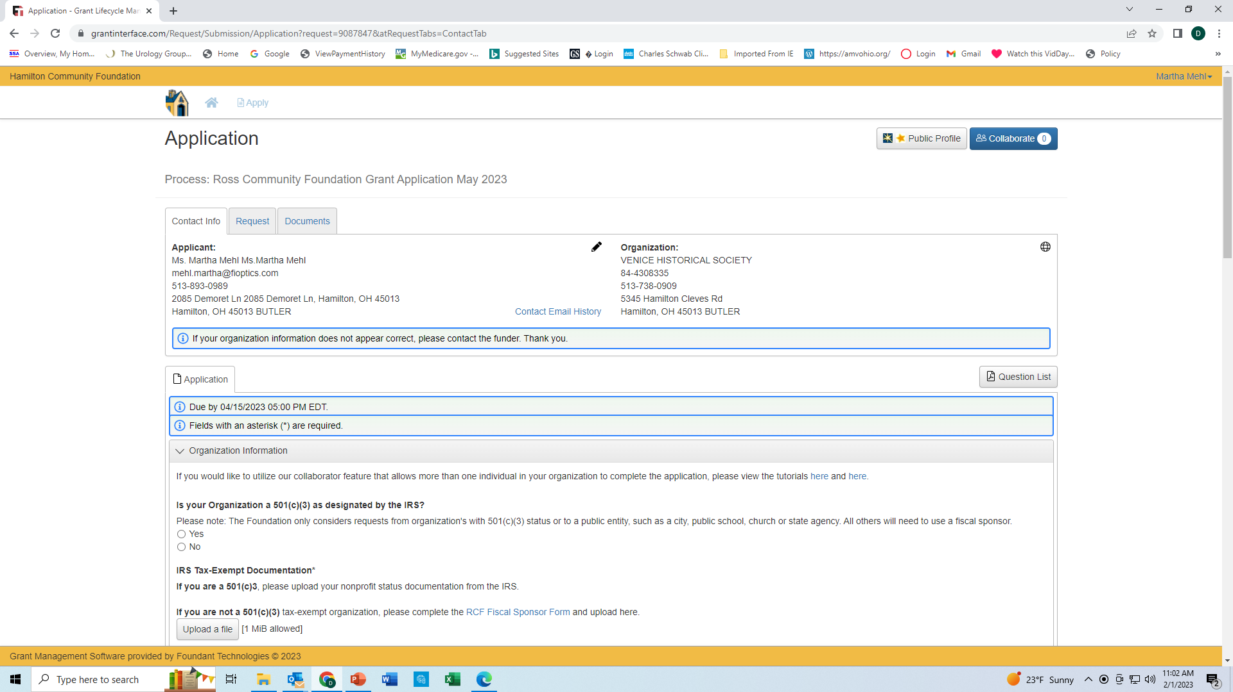
.
Notes:
So you have applied now it is time to complete all of the questions on the RCF application.
Briefly review the Applicant and Organization information . If your organization does not appear contact the funder at 513-863-1717
Let’s move to the first question. Upload EIN or Fiscal Sponsor by clicking on the button
Next

Slide 13
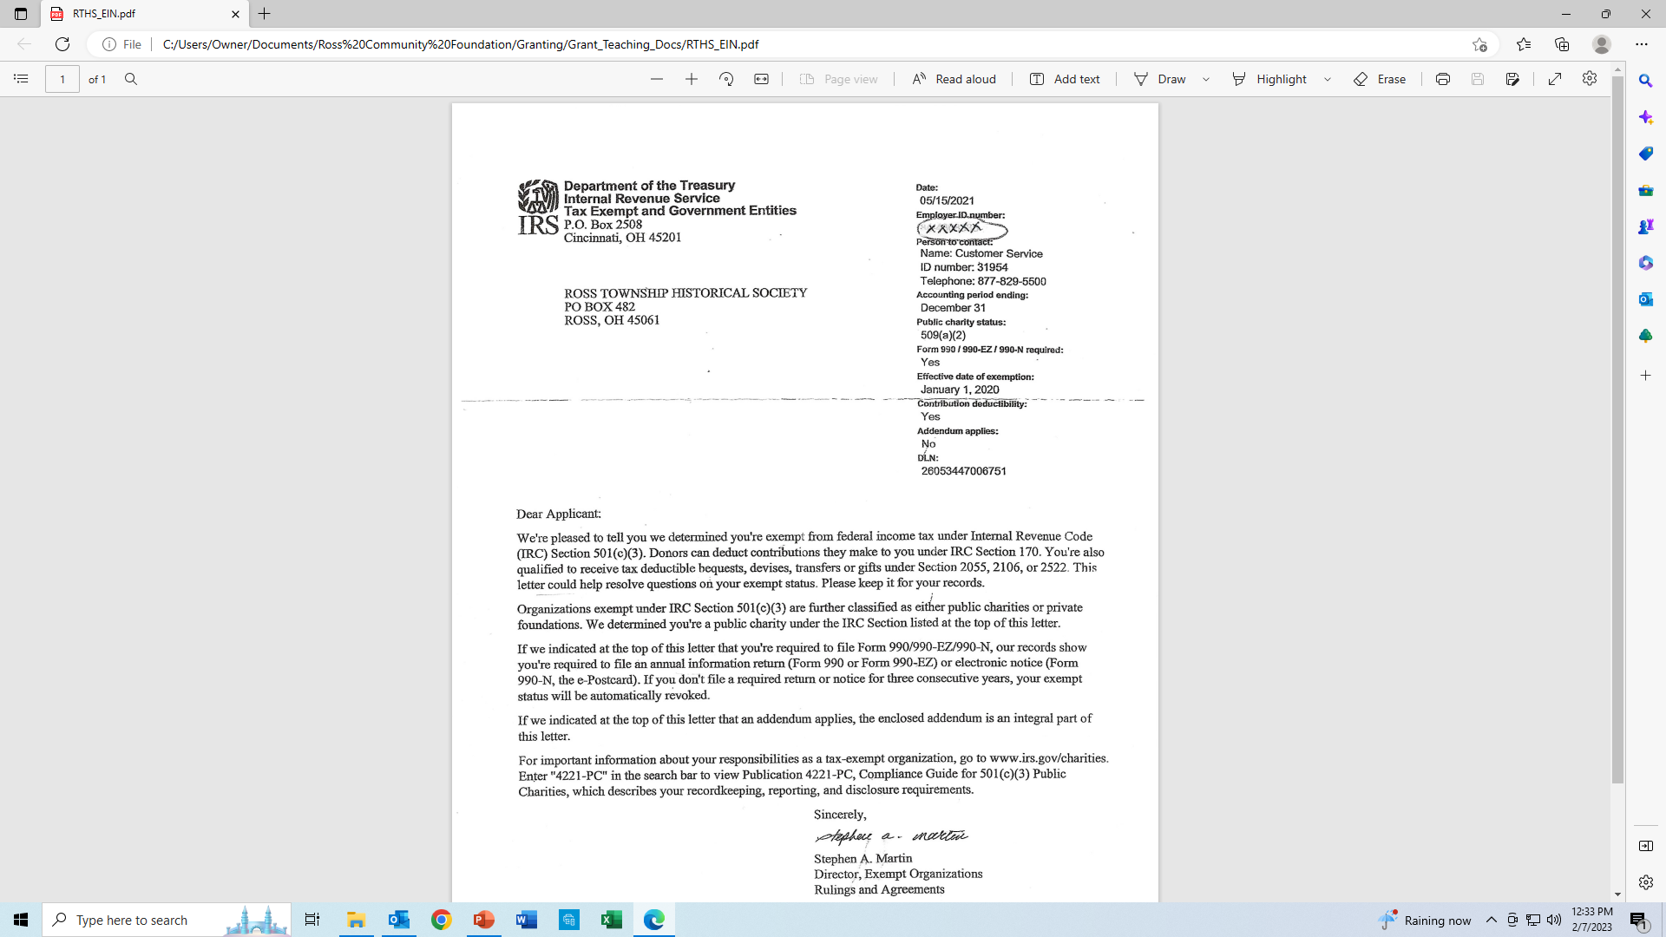
IRS Tax Exempt Documentation
Venice Historical Society
5445 Hamilton Cleves Rd
Hamilton, OH 45013
Notes:
This is an example of a 501c3 notice from the IRS for the Venice Historical Society the fake organization we will use in our training today . Note that the number is called a EIN Employee Identifications Number.
If you do not have a EIN / 501c3 number you can submit a completed Fiscal Sponsor form. Click on the ICON shown.
Next

Slide 14
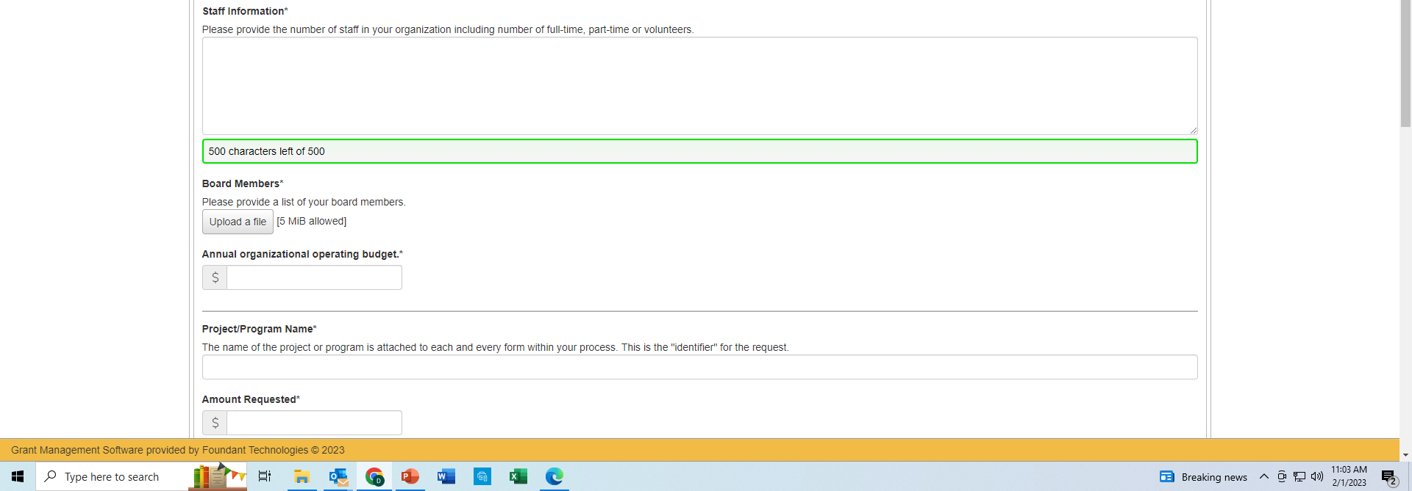
The Venice Historical Society has a 5 Voluntary Board members ( President, Vice President, Treasurer, Advertisement and Education Coordinators), 1 part – time paid Secretary and 1 full time paid Curator.
Notes:
Review Staff information question
Review Board Members and the need to upload a copy. In our example the VHS listed the names and titles .
Next

Slide 15
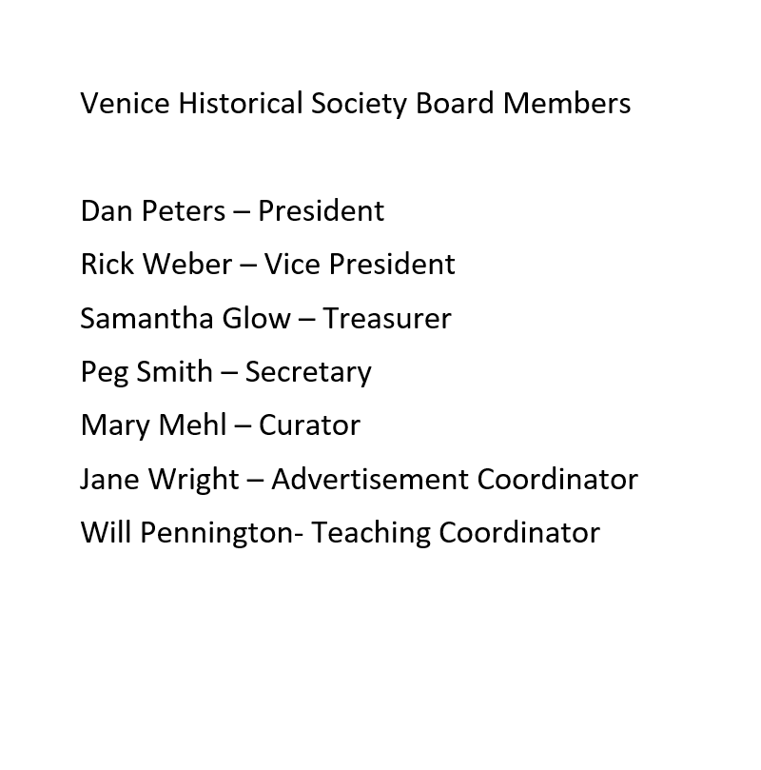
Notes:
Here is a list of the Board members by name and tile
Next

Slide 16
The Venice Historical Society has a 5 Voluntary Board members ( President, Vice President, Treasurer, Advertisement and Education Coordinators), 1 part – time paid Secretary and 1 full time paid Curator.
$1000.00
1875 Butler County Atlas Restoration
$700.00
Notes:
Enter your organization Annual Operating Budget. In our example the VHS has a budget of $ 1000.00
Next enter the Project / Program name . Note that this is the identifier for the request. In our example the VHS has called their project 1875 Butler County Atlas Restoration.
Next enter the amount Requested. In our example VHS is asking for $700.00
Next

Slide 17
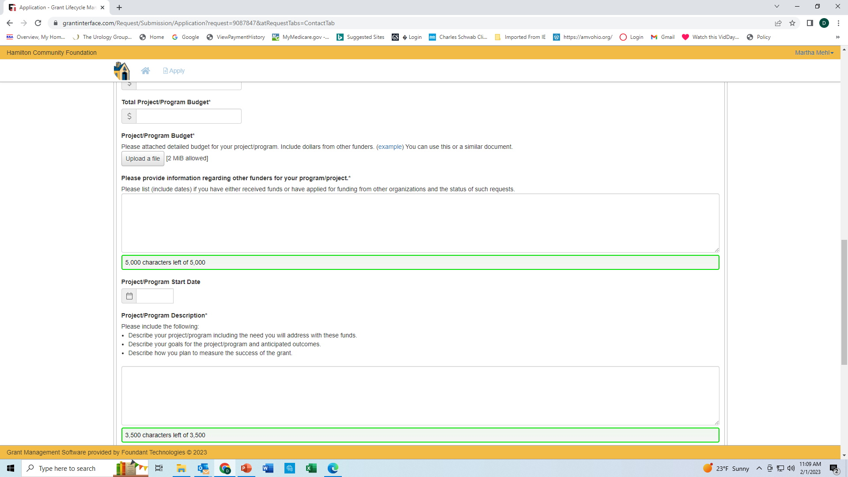
$700.00
Notes:
Enter the Total Project / Program budget in our example the VHS Request amount is the same as the Project amount .
Next

Slide 18
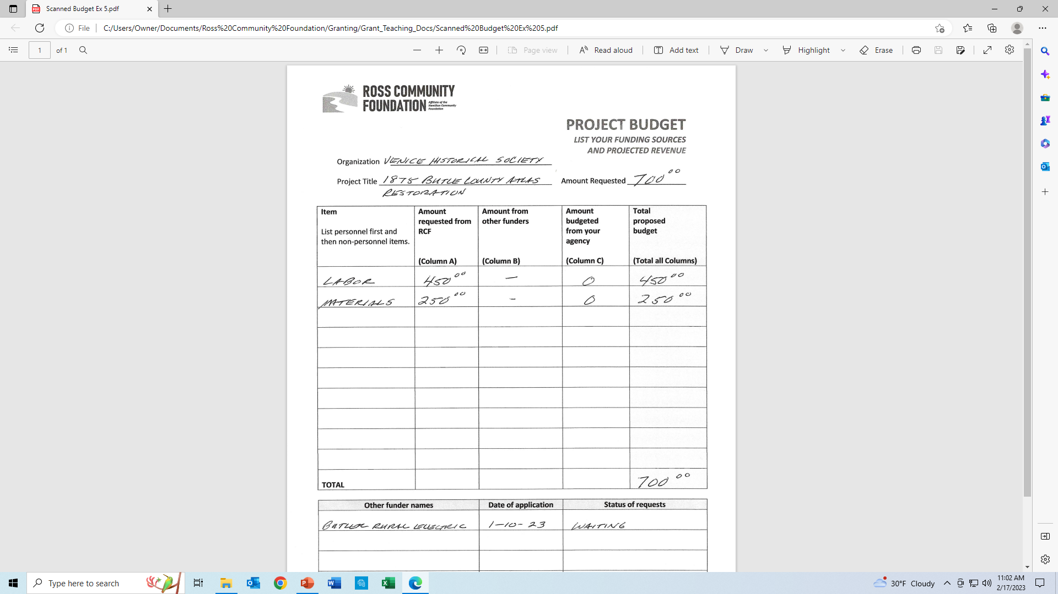
Example: Project Budget
Notes:
Here is the budget for the VHS project .
Note how VHS broke out labor and materials. Your project may be more complex and could include salaries, IT costs, transportation etc .

Slide 19
$700.00
As of January 1, 2023 the Venice Historical Society has applied for a grant from Butler Rural Electric for $700.00 . We will receive an answer in March . No other grant requests have been submitted for this project
6/1/2023
The 1875 Butler County Atlas was a donation made to the VHS in late 2022. The atlas is in poor but all pages and illustrations are present. The atlas is the most historical valued item in the VHS collection to date. The restoration will be completed by a skilled bindery resulting in a piece of significant Ross and Butler County history to be enjoy by all who read it. Once completed the Atlas will be used in conducting historical classes to third grade students at Ross school planned for early 2024. In addition it can be used as a genealogical research reference by local historians. Frequency of use, comments and reactions from students in the classroom can be used as a measure of success for this project.
Notes:
Let’s continue to complete our application.
We have the Total Project Budget entered and have uploaded the file .
Next complete Information regarding other funders for your project . In the case of the VHS they applied for funds from the Butler Rural Cooperative and are awaiting a response.
Next enter the Project Start Date
Next complete the Project Description please include a description, anticipated outcomes and measures of success . In the case of the VHS they have acquired a rare historical Atlas and have plans for it’s use in education once it is restored. Note: good description, the need for the renovation and the success measure.
Next

Slide 20
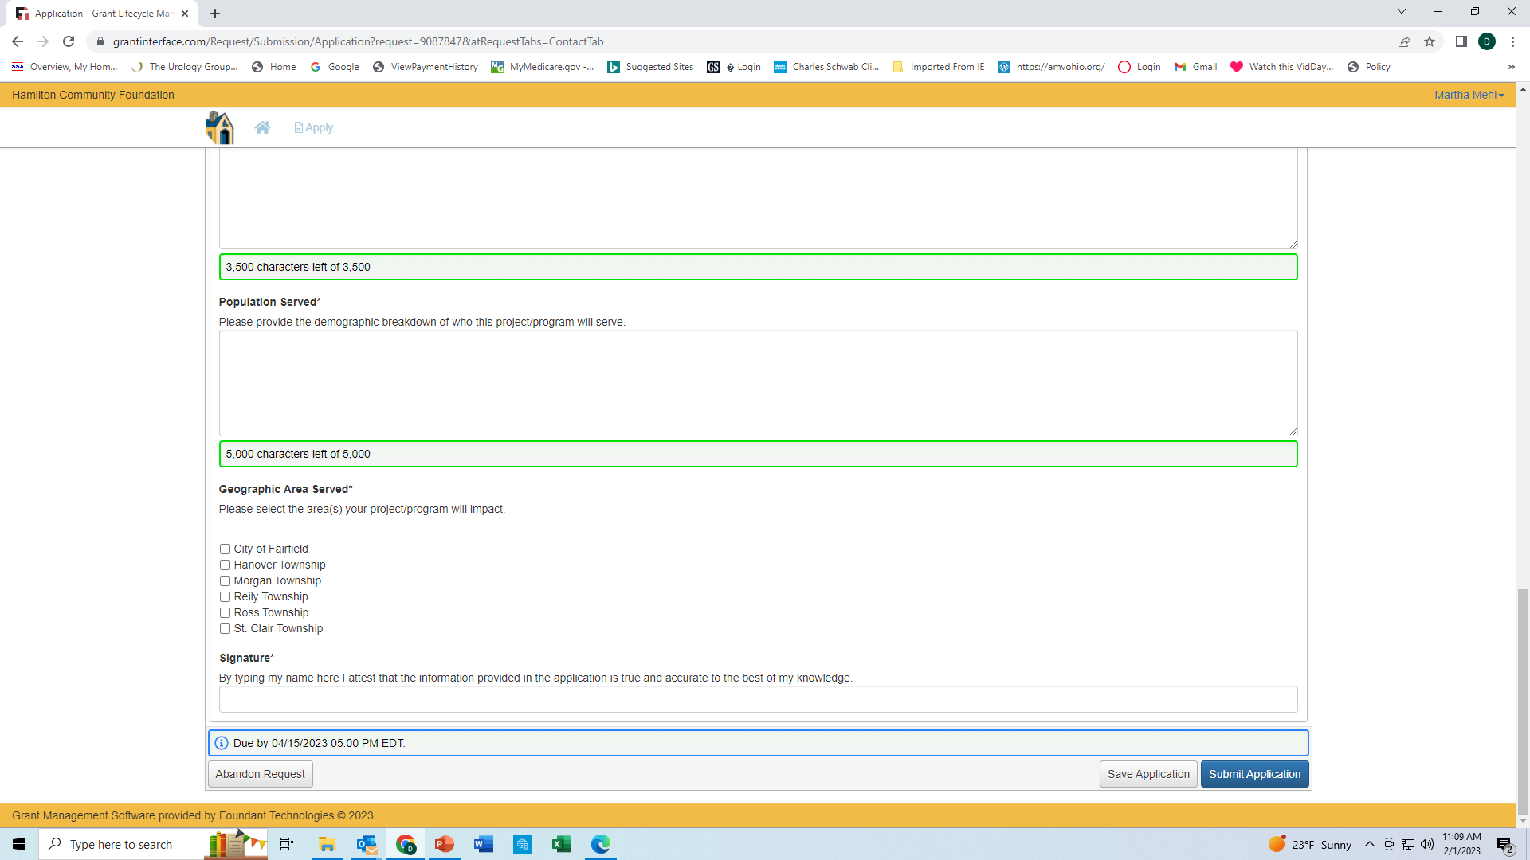
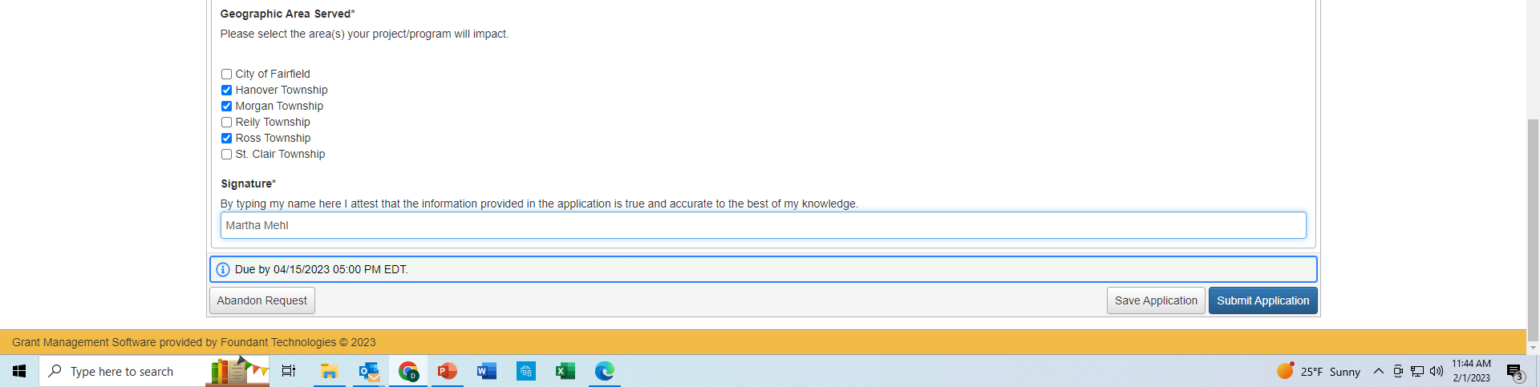
The VHS has 40 members monthly meeting with guest speakers are conducted February through November. Attendees are from local communities, Ross, Shandon, Fairfield and Okeana. The atlas will be available to both members and non- members for research purposes. Planned classes will start with approximately 90 3rd grade students from Ross Elementary schools in early 2024.
Notes:
Only a few more questions and the VHS will be able to submit their project .
Complete the question on Population Served try and break down the demographics. The VHS has members from several communitas . The Atlas will be used in planned historical presentations in Ross school classes and as a reference for genealogical research which would add to the demographic impact.
Next check off the Geographic area(s) served
Finally sign the document
HIT Submit Application

Slide 21
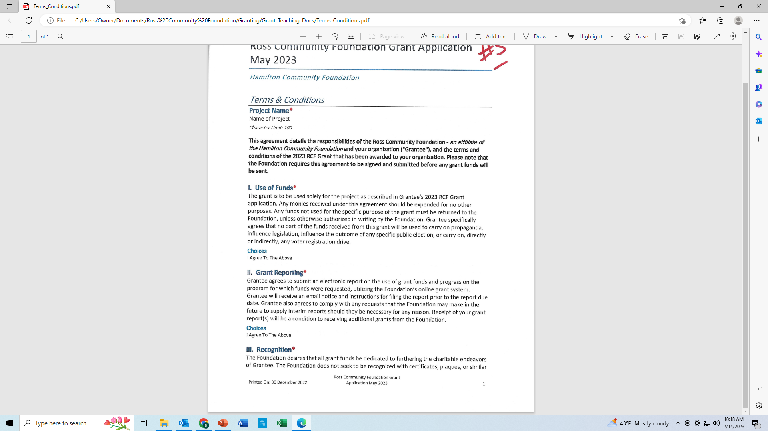
Terms and Conditions
Use of Funds
Grant Reporting
Recognition
Automated Clearing House (ACH)
Signature
Notes:
We are almost done just one more form to review. When you have complete your application you will need to complete a Terms and Conditions form it is a requirement in order to receive the grant . Basically this is a form that states what the Grantee ( you and your organization) and RCF will agree to when it comes to the following topics.
Use of Funds- The grant is to be used solely for the project as described in your application. THIS IS IMPORTANT THE GRANT MUST BE USED FOR THE PROJECT
INTENDED (or RCF could request the funds be returned)
Grant Reporting- The Grantee agrees to submit an electronic report on the use of funds and progress on the program for which funds were requested.
Recognition- The RCF reserves the right to review and approve all written or spoken public announcements that use the Foundations name or logo.
ACH- Payments will be made to the Grantee utilizing ACH Automated Clearing House. Grantees need to set up a electronic transfer of funds in order to receive grant funds.

Slide 22

Grant Application Period is OPEN
and will CLOSE on April 15, 2024!
Thank you

